Slide 1
INVERSE PROBLEM FOR LIGHT SPREADING APPLIED TO MEDICAL TOMOGRAPHY
Desmond Roussel Ngueguin
Under the supervision of:
Emmanuel Franck
Laurent Navoret
Vincent Vigon
For the teaching unit: “Projet”
Overseen by Christophe Prud'homme
May 27, 2020

Slide 2
CONTENT
CONTEXT
DESCRIPTION
ROADMAP
Mathematical basis
Solving the model
RESULTS
Test cases
Data analysis
MILESTONES
CHALLENGES
PERSPECTIVES
REFERENCES

Slide 3
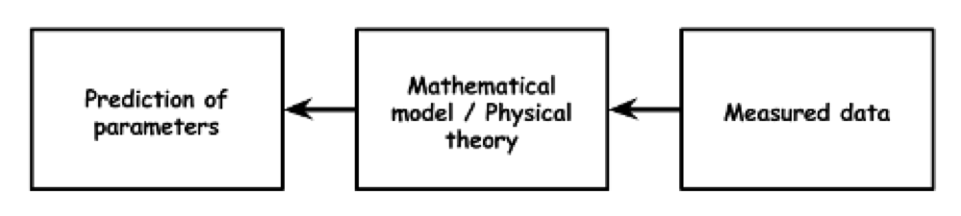
CONTEXT
Proposed by the MOCO Team at IRMA
Inverse problems encountered in:
medical imaging,
computer vision,
radar, etc.
Hard to solve!!!
Figure 1: Inverse problem (Subramaniyam, 2018)

Slide 4
DESCRIPTION
Objectives
Solve the forward problem for light spreading
Get ready for AI prediction using neural networks
Tasks
Read about the mathematical model to be used
Implement the numerical scheme using the finite volumes method
Run test cases
Analyze the data
Write the reports
Present the work that was done
Figure 2: Near-infrared spectroscopy (Nakagawa et al., 2017)

Slide 5
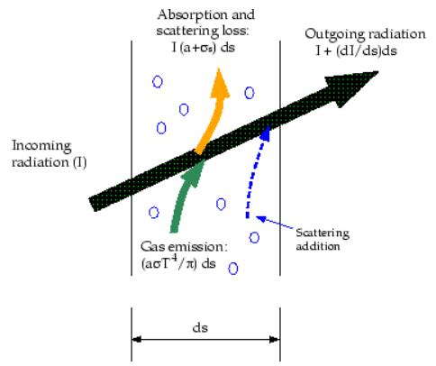
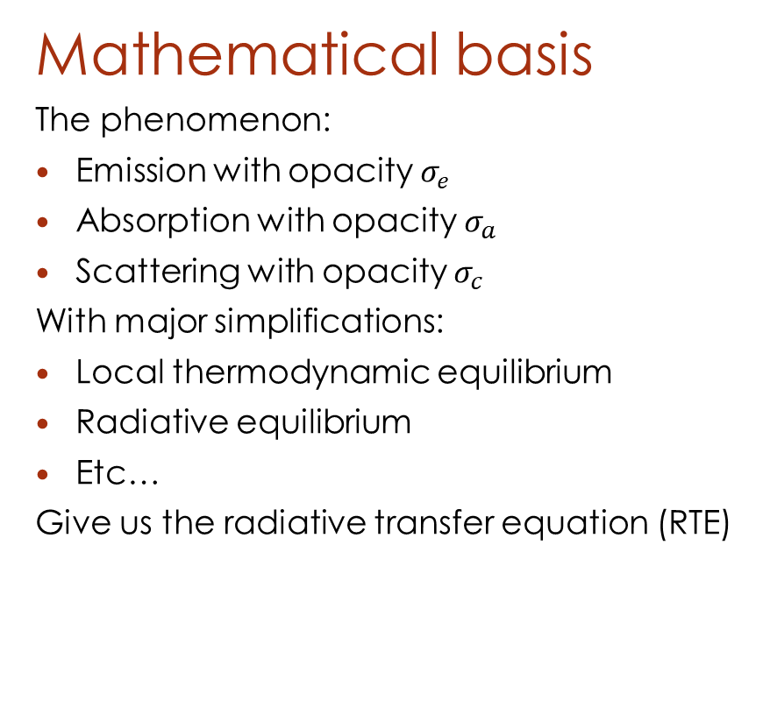
ROADMAP
Mathematical basis
The phenomenon:
Emission with opacity $σ_{e}$
Absorption with opacity $σ_{a}$
Scattering with opacity $σ_{c}$
With major simplifications:
Local thermodynamic equilibrium
Radiative equilibrium
Etc…
Give us the radiative transfer equation (RTE)
Figure 3: Radiative transfer phenomenon in a gas (Ansys Fluent, n.d)

Slide 6
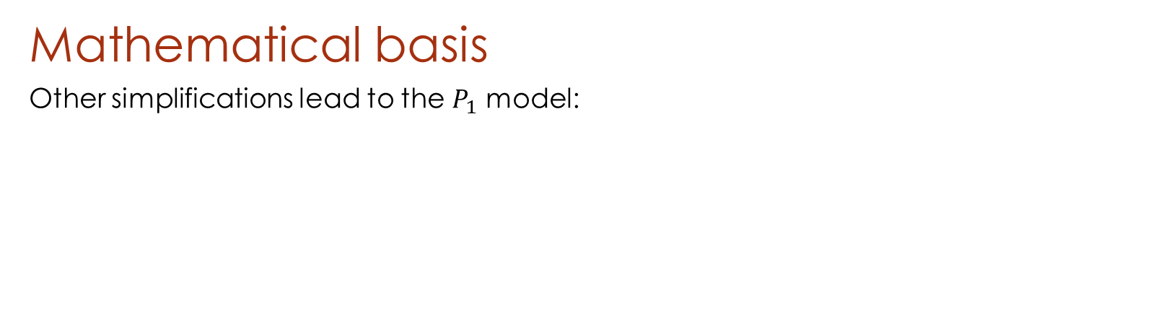
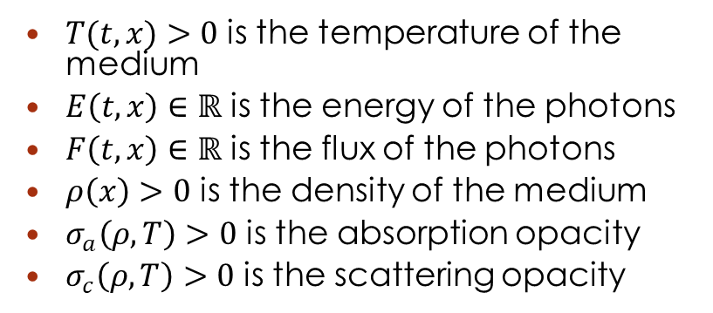
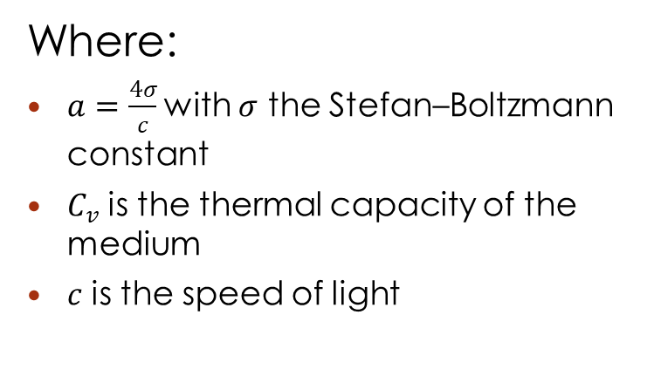
ROADMAP
Mathematical basis
Other simplifications lead to the $P_{1}$ model:
Where:
$a=\frac{4σ}{c}$with $σ$ the Stefan–Boltzmann constant
$C_{v}$ is the thermal capacity of the medium
$c$ is the speed of light
$T(t, x)>0$ is the temperature of the medium
$E\left(t, x\right)∈ℝ$ is the energy of the photons
$F\left(t, x\right)∈ℝ$ is the flux of the photons
$ρ\left(x\right)>0$ is the density of the medium
$σ_{a}\left(ρ, T\right)>0$ is the absorption opacity
$σ_{c}\left(ρ, T\right)>0$ is the scattering opacity

Slide 7
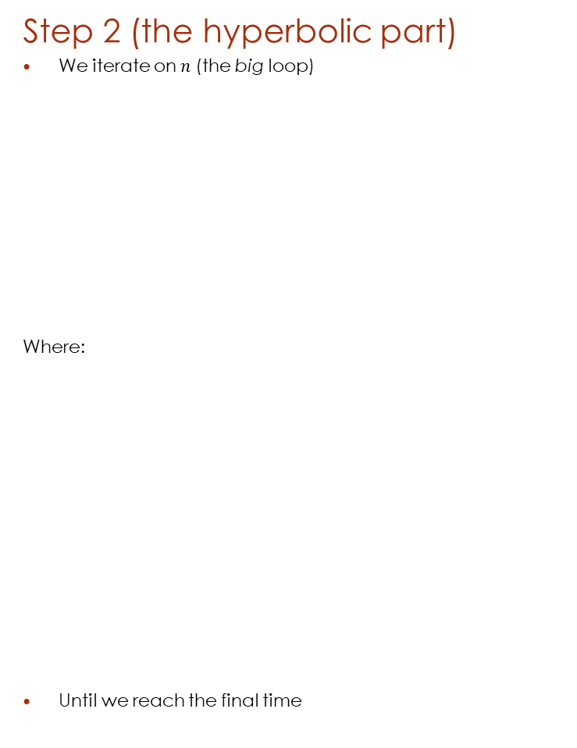
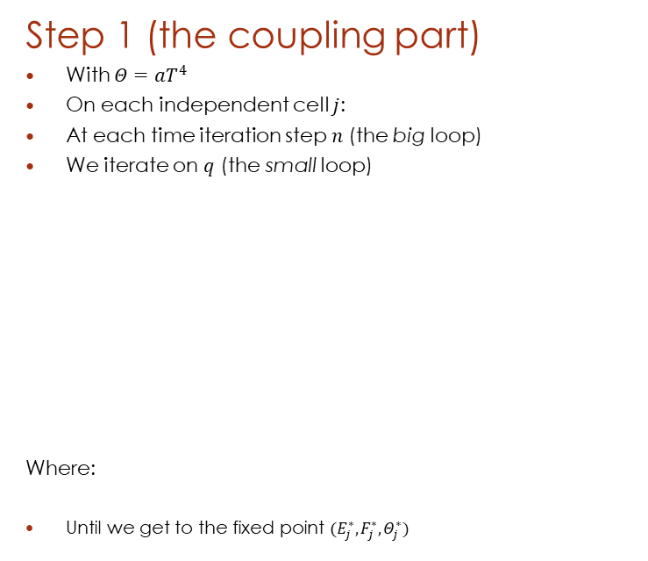
ROADMAP
Step 2 (the hyperbolic part)
We iterate on$n$ (the big loop)
Where:
Until we reach the final time
Solving the problem
Using the finite volumes method
Using a “splitting” scheme
CFL condition for stability:
Step 1 (the coupling part)
With $Θ=aT^{4}$
On each independent cell $j$:
At each time iteration step $n$ (the big loop)
We iterate on $q$ (the small loop)
Where:
Until we get to the fixed point $(E_{j}^{∗}, F_{j}^{∗}, Θ_{j}^{∗})$

Slide 8
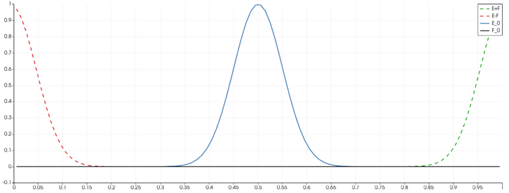
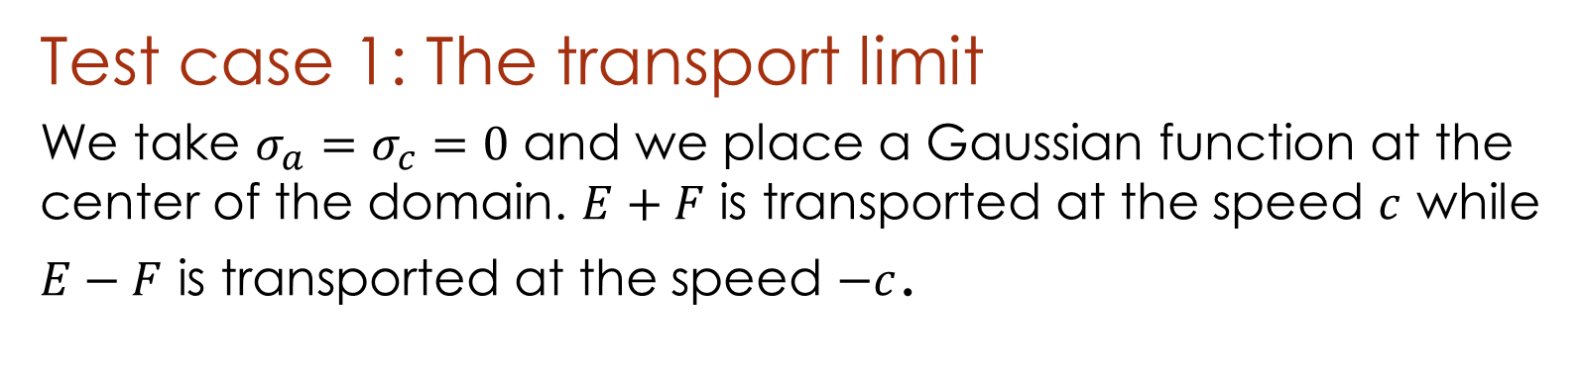
RESULTS
Test case 1: The transport limit
We take $σ_{a}=σ_{c}=0$ and we place a Gaussian function at the center of the domain. $E+F$ is transported at the speed $c$ while $E−F$ is transported at the speed $−c$.
Figure 4: Transport limit

Slide 9
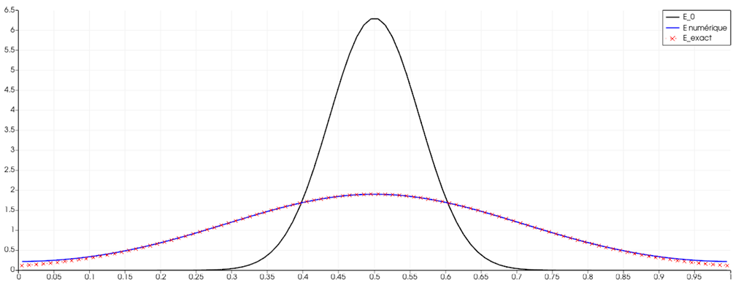
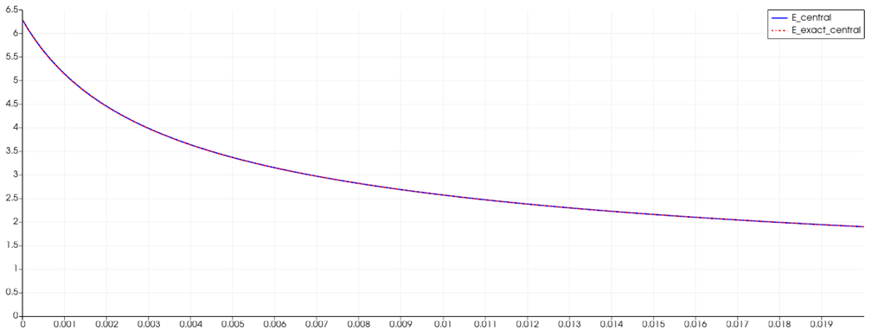
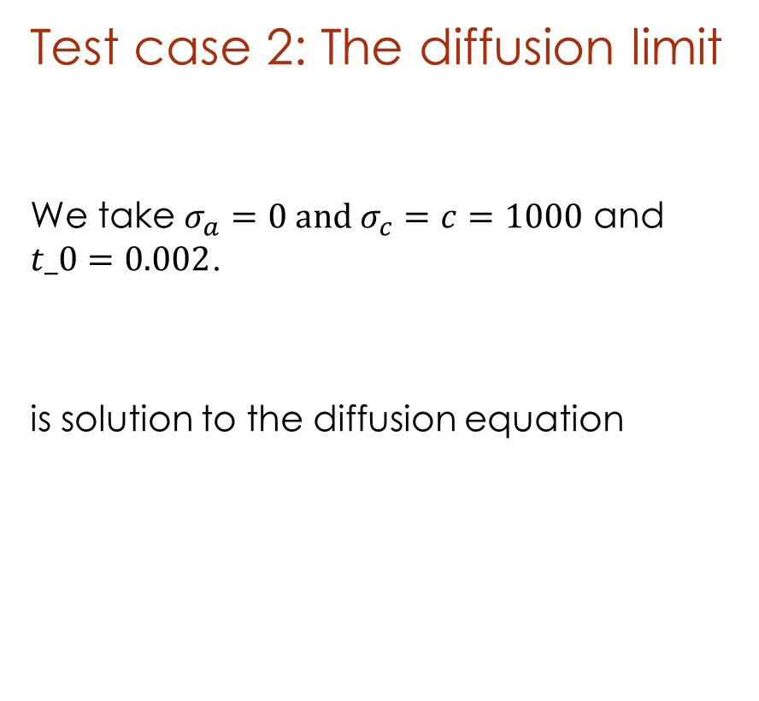
RESULTS
Test case 2: The diffusion limit
We take $σ_{a}=0 \text{and} σ_{c}=c=1000$ and $t_0=0.002$.
is solution to the diffusion equation
Figure 5: Spatial visualization for the diffusion limit
Figure 6: Temporal decrease in energy at the center of the domain for the diffusion limit

Slide 10
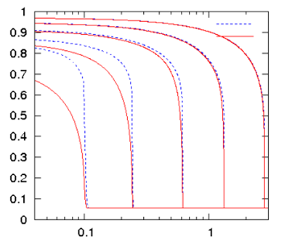
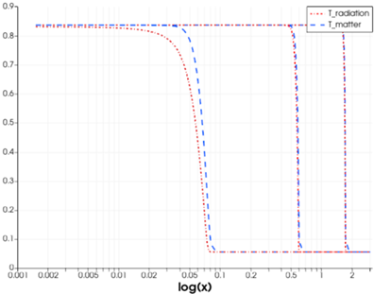
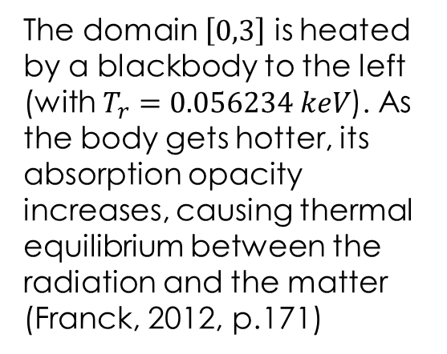
RESULTS
Test case 3: Olson-Auer-Hall
The domain $\left[0,3\right]$ is heated by a blackbody to the left (with $T_{r}=0.056234 keV$). As the body gets hotter, its absorption opacity increases, causing thermal equilibrium between the radiation and the matter (Franck, 2012, p.171)
Figure 7: Expected results for t=1/c, 3/c, 10/c, 30/c, and 100/c (Franck, 2012, p.171)
Figure 8: Obtained results for t=0.1/c, 1/c, and 3/c

Slide 11
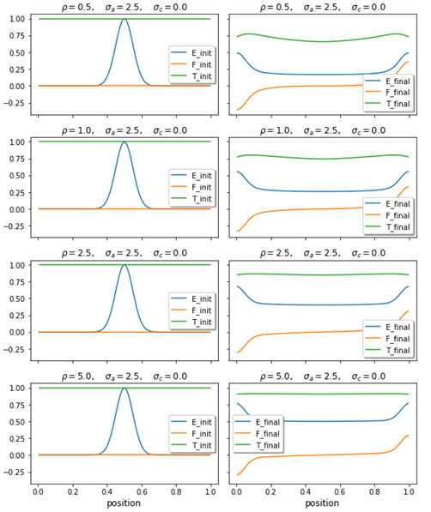
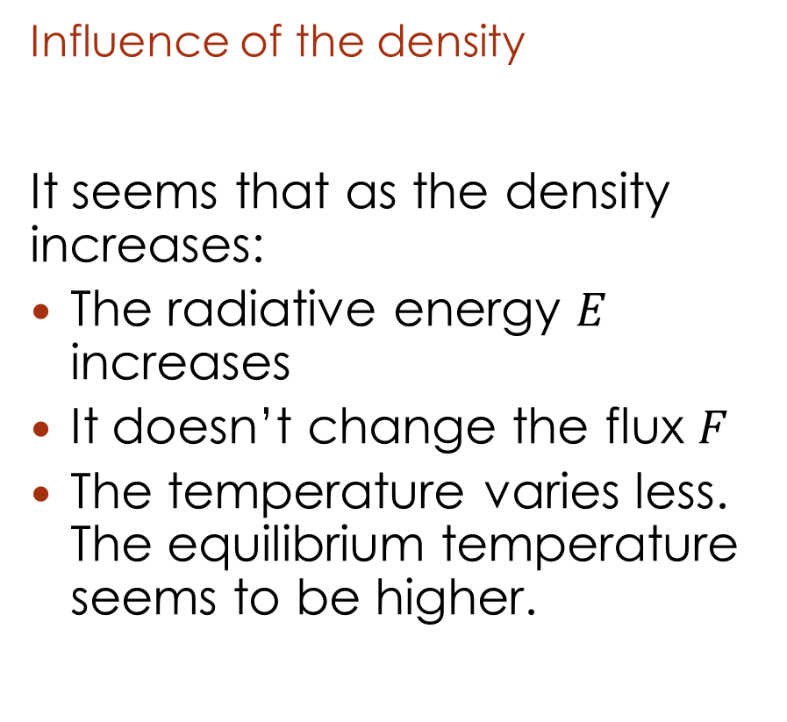
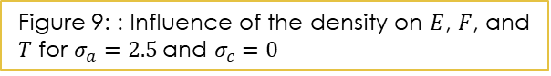
RESULTS
Influence of the density
It seems that as the density increases:
The radiative energy $E$ increases
It doesn’t change the flux $F$
The temperature varies less. The equilibrium temperature seems to be higher.
Figure 9: : Influence of the density on $E$, $F$, and $T$ for $σ_{a}=2.5$and $σ_{c}=0$

Slide 12
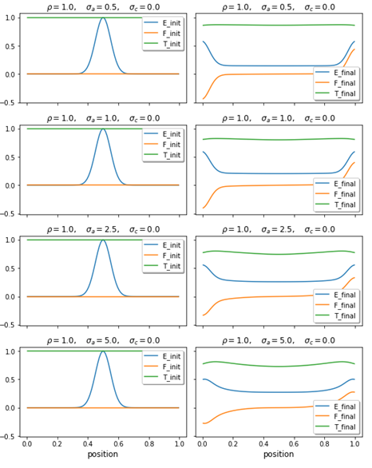
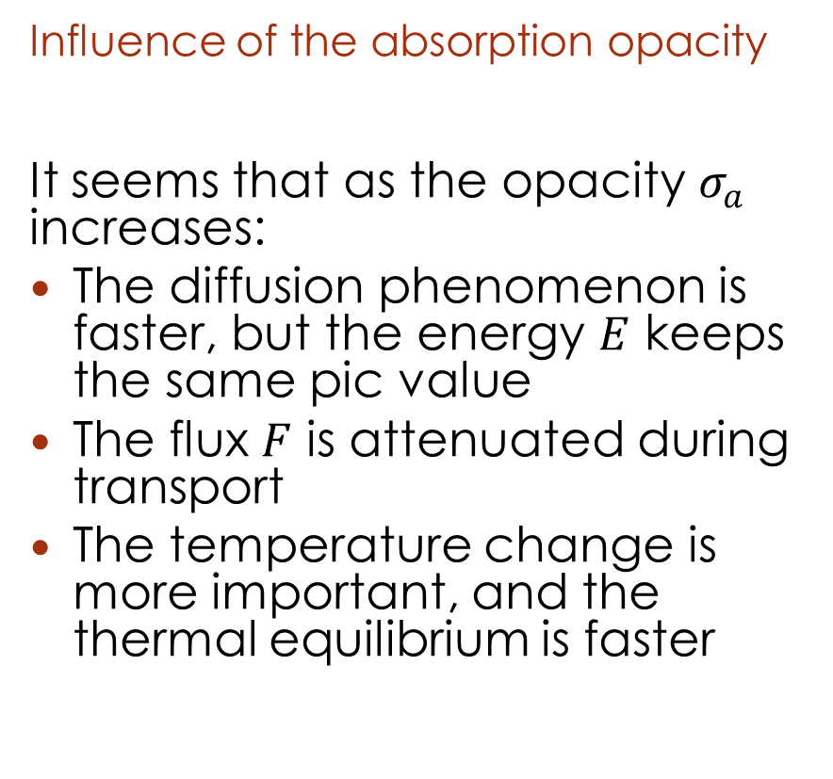
RESULTS
Influence of the absorption opacity
It seems that as the opacity $σ_{a}$ increases:
The diffusion phenomenon is faster, but the energy $E$ keeps the same pic value
The flux $F$ is attenuated during transport
The temperature change is more important, and the thermal equilibrium is faster
Figure 10: Influence of $σ_{a}$ for $ρ=1$ and $σ_{c}=0$

Slide 13
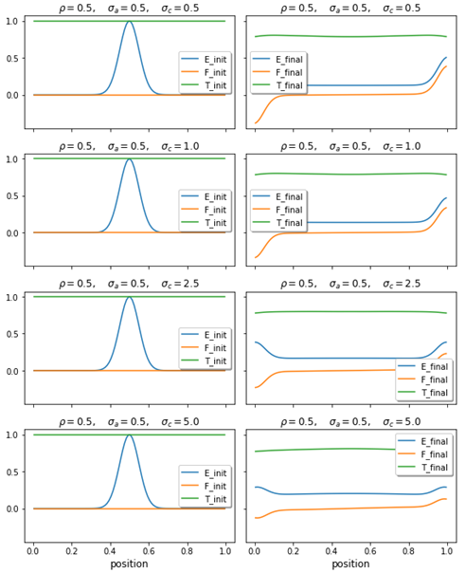
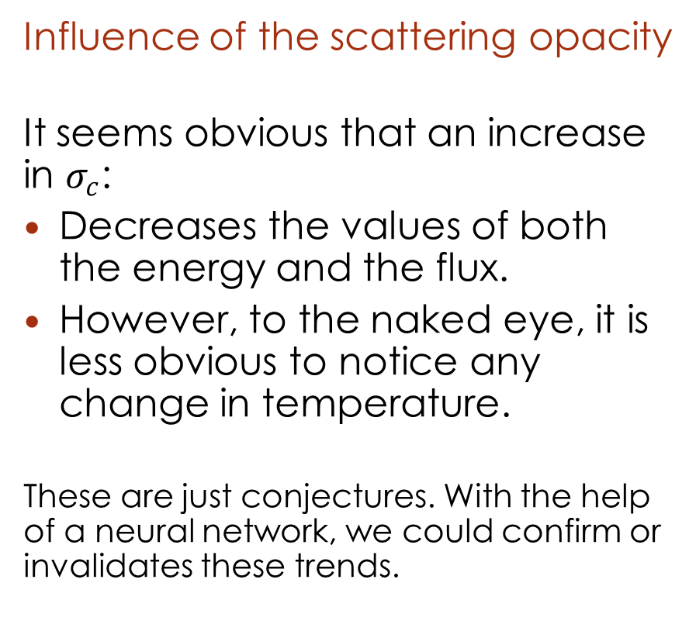
RESULTS
Influence of the scattering opacity
It seems obvious that an increase in $σ_{c}$:
Decreases the values of both the energy and the flux.
However, to the naked eye, it is less obvious to notice any change in temperature.
These are just conjectures. With the help of a neural network, we could confirm or invalidates these trends.
Figure 11: Influence of $σ_{c}$ for $ρ=0.5$ and $σ_{a}=0.5$

Slide 14
MILESTONES

Slide 15
CHALLENGES
Notations and nomenclature (stellar atmosphere in astrophysics, nuclear fusion by inertial confinement, etc…)
Performance in the C++ implementation of the scheme

Slide 16
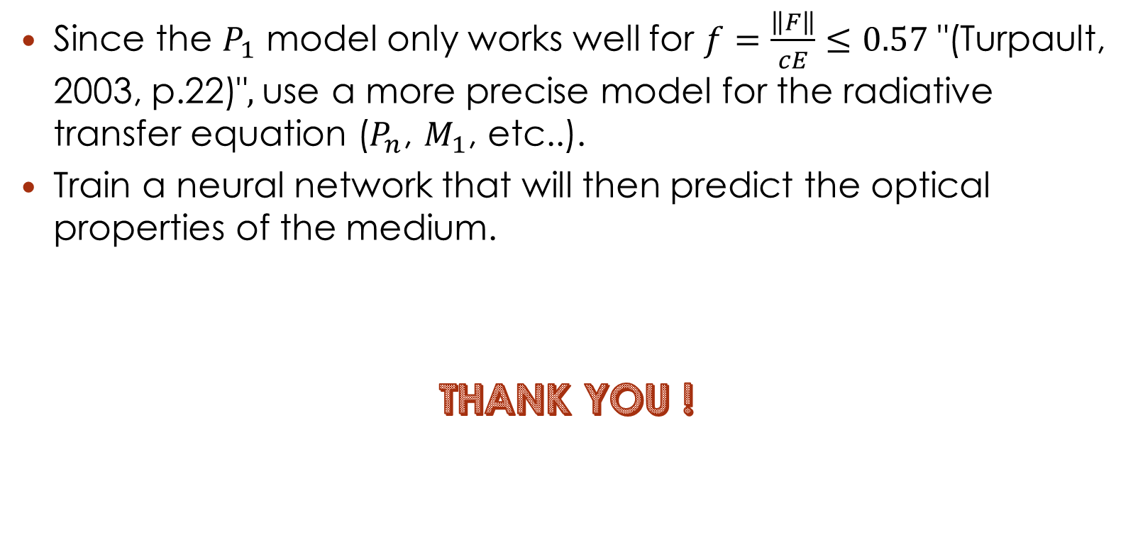
PERSPECTIVES
Since the $P_{1}$ model only works well for $f=\frac{\left\|F\right\|}{cE}≤0.57$ "(Turpault, 2003, p.22)"$,$use a more precise model for the radiative transfer equation ($P_{n}$, $M_{1}$, etc..).
Train a neural network that will then predict the optical properties of the medium.
THANK YOU !

Slide 17
REFERENCES
Subramaniyam, P. (2018). “The Inverse Problem in EEG – Assumptions and Pitfalls”. Retrieved from https://sapienlabs.org/the-inverse-problem-in-eeg/
Franck, E. October 23, 2012. “Construction et analyse numérique de schéma asymptotic preserving sur maillages non structurés. Application au transport linéaire et aux systèmes de Friedrichs”. Retrieved from https://tel.archives-ouvertes.fr/file/index/docid/744371/filename/theseFranckv3.pdf
Nakagawa, I. et al., (2017). “Indocyanine green kinetics with near-infrared spectroscopy predicts cerebral hyperperfusion syndrome after carotid artery stenting”. Retrieved from https://journals.plos.org/plosone/article/figure?id=10.1371/journal.pone.0180684.g002
Ansys Fluent. (n.d). “Radiative Transfer Equation”. Retrieved from https://www.afs.enea.it/project/neptunius/docs/fluent/html/th/node111.htm
Turpault, R. (2003). "Modelisation, approximation numerique et applications du transfert radiatif en desequilibre spectral couple avec l’hydrodynamique". Mathématiques [math]. Université Sciences et Technologies - Bordeaux I, 2003. Français. tel-00004620

